Slide 1
Biological Modeling of Neural Networks
Week 4: Reducing Detail – 2D models-Adding Detail
3.1 From Hodgkin-Huxley to 2D
3.2 Phase Plane Analysis
3.3 Analysis of a 2D Neuron Model
4.1 Type I and II Neuron Models
- limit cycles
- where is the firing threshold?
- separation of time scales
4.2. Adding Detail
- synapses
-dendrites
- cable equation
Week 4
– Reducing detail
- Adding detail
Wulfram Gerstner
EPFL, Lausanne, Switzerland
Notes:
Ich habe 1 mal 45 Minuten (bis zum Quiz) und dann nochmals 25 Minuten
gebraucht um das Kapitel 4.1 abzuschliessen (danach direkt das integrierte Exercise 1 von 10:40 bis 10:55).
Dadurch hatte ich zu wenig Zeit fuer die Cable equation. Und die slides
Zu compartmental neurons mit active dendrites habe ich auch nicht gezeigt.
Und short-term synaptic plasticity flog schon vorher raus.
WAS KANN ICH RAUSWERFEN?
Nur ein paar slides? – das reicht nicht.
AM BESTEN:
Das ganze Kapitel 4.2 ‘adding detail’ auf spaeter verschieben.
Und stattdessen den Uebergang zu nonlinear I&F (exponential IF model) wieder dazunehmen.
Die haengen im diesem File hier ganz am Ende noch dran. Aber das waere ein runder
Abschluss fuer diesen Teil.
Bei 4.2:
Synapsen?
Dauer ungefaehr 10 Minuten;
Aber man muesste Synapsen gruendlicher mit short-term plasticity (slides im MOOC) machen und dafuer
DENDRITEN rauswerfen.
ODER Active Dendrites/compartmental models wieder reinnehmen?
Vielleicht cable equation erst spaeter zusammen mit compartmental modeling?
ODER: noch den Uebergang von 2D model zu exponential IF (das hatte ich im MOOC mit drin)?
Dann waere das ganze ‘Adding Detail’ ein spaeteres Kapitel (eigene Woche wie im MOOC)

Slide 2
Neuronal Dynamics – Review from week 3
Reduction of Hodgkin-Huxley to 2 dimension
-step 1: separation of time scales
-step 2: exploit similarities/correlations

Slide 3
Neuronal Dynamics – 4.1. Reduction of Hodgkin-Huxley model
1) dynamics of m are fast
2) dynamics of h and n are similar
w(t)
w(t)

Slide 4
Neuronal Dynamics – 4.1. Analysis of a 2D neuron model
2-dimensional equation
stimulus
w
I(t)=I₀
Enables graphical analysis!
u
Pulse input
→ AP firing (or not)
Constant input
→ repetitive firing (or not)
→ limit cycle (or not)

Slide 5
Week 4 – part 1: Reducing Detail – 2D models
ramp input/
constant input
3.1 From Hodgkin-Huxley to 2D
3.2 Phase Plane Analysis
3.3 Analysis of a 2D Neuron Model
4.1 Type I and II Neuron Models
- limit cycles
- where is the firing threshold?
- separation of time scales
4.2. Dendrites
neuron
I0
Type I and type II models
f-I curve
f-I curve
f
I0
I0

Slide 6
Neuronal Dynamics – 4.1. Type I and II Neuron Models
neuron
ramp input/
constant input
I0
Type I and type II models
f-I curve
f-I curve
f
I0
I0

Slide 7
2 dimensional Neuron Models
stimulus
w
w-nullcline
I(t)=I₀
apply constant stimulus I0
u
u-nullcline

Slide 8
FitzHugh Nagumo Model – limit cycle
stimulus
w
I(t)=I₀
-unstable fixed point
-closed boundary
with arrows pointing inside
u
limit cycle
limit cycle

Slide 9
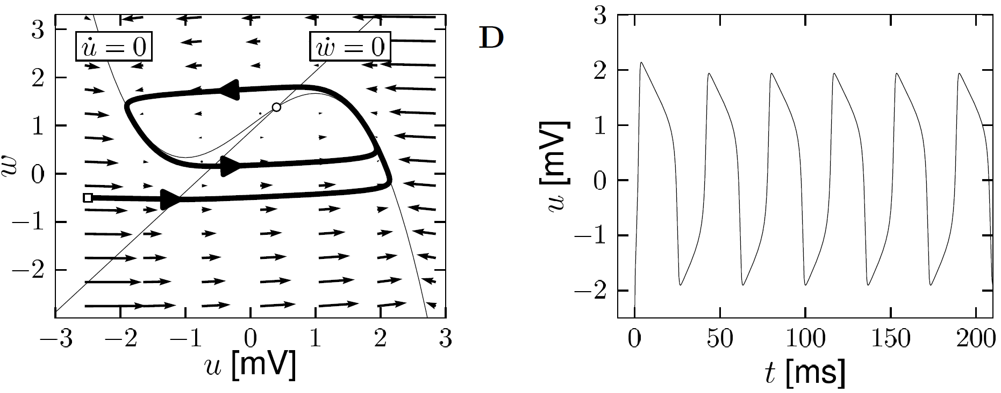
Neuronal Dynamics – 4.1. Limit Cycle
-unstable fixed point in 2D
-bounding box with inward flow
→ limit cycle (Poincare Bendixson)
Image: Neuronal Dynamics,
Gerstner et al.,
Cambridge Univ. Press (2014)

Slide 10
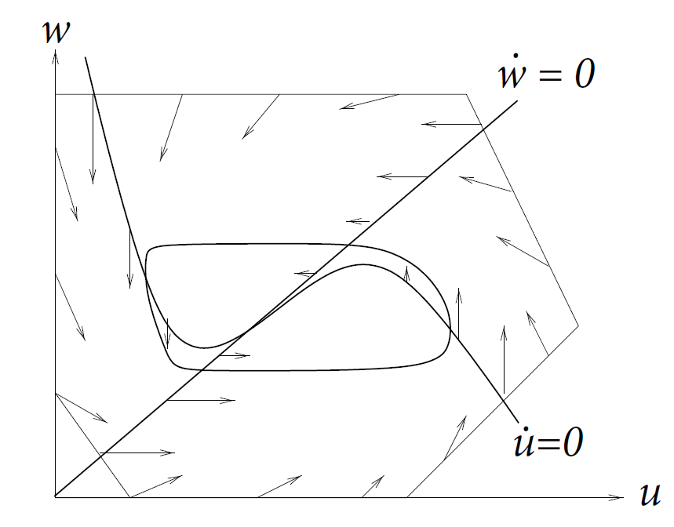
Neuronal Dynamics – 4.1. Limit Cycle
In 2-dimensional equations,
a limit cycle must exist, if we can
find a surface
-containing one unstable fixed point
-no other fixed point
-bounding box with inward flow
→ limit cycle (Poincare Bendixson)
Image: Neuronal Dynamics,
Gerstner et al.,
Cambridge Univ. Press (2014)

Slide 11
Type II Model
constant input
stimulus
w
Hopf bifurcation
I(t)=I₀
u
Discontinuous gain function
I₀
Stability lost → oscillation with finite frequency

Slide 12
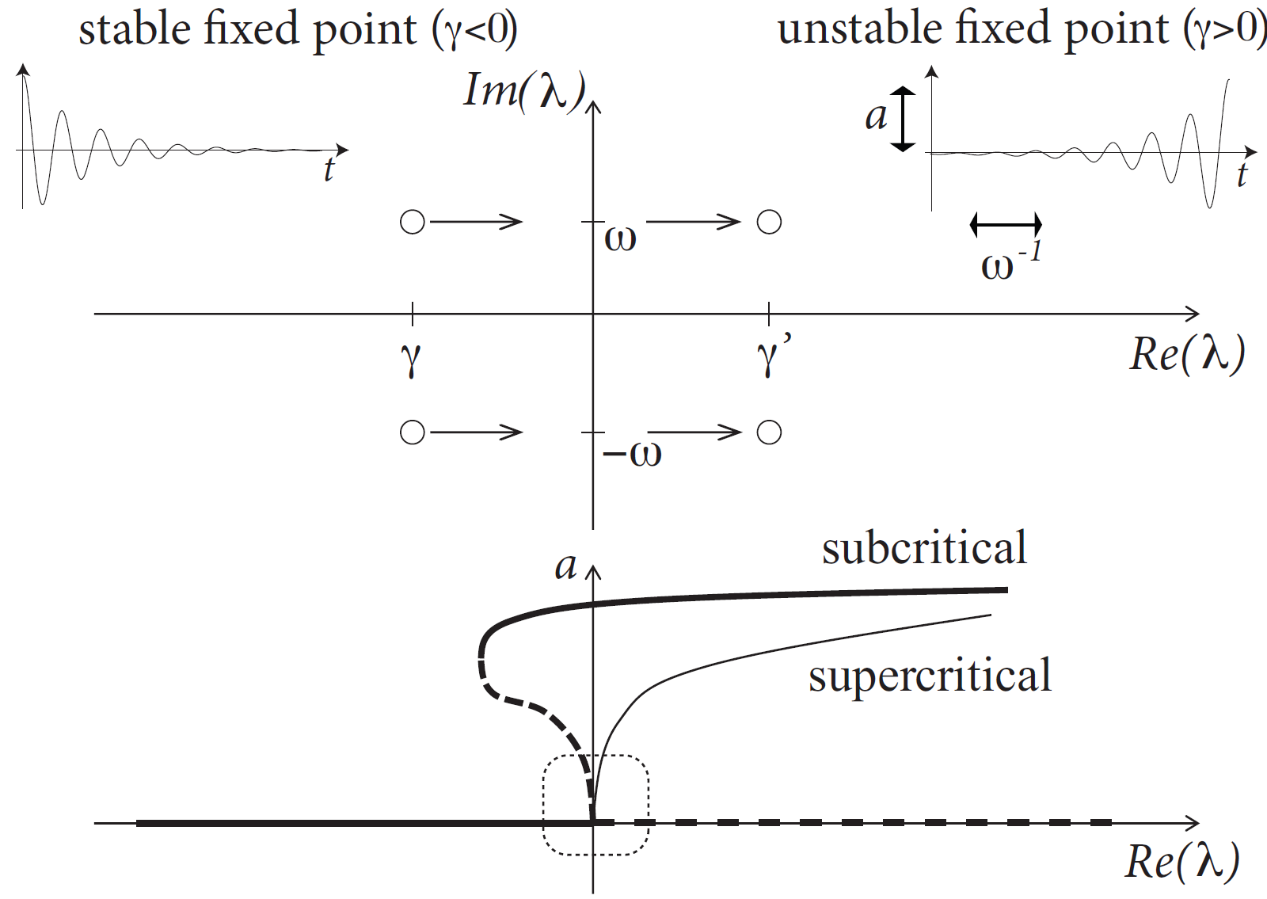
Neuronal Dynamics – 4.1. Hopf bifurcation

Slide 13
Neuronal Dynamics – 4.1. Hopf bifurcation: f-I -curve
f-I curve
Discontinuous
gain function: Type II
ramp input/
constant input
I0
I₀
Stability lost → oscillation with finite frequency

Slide 14
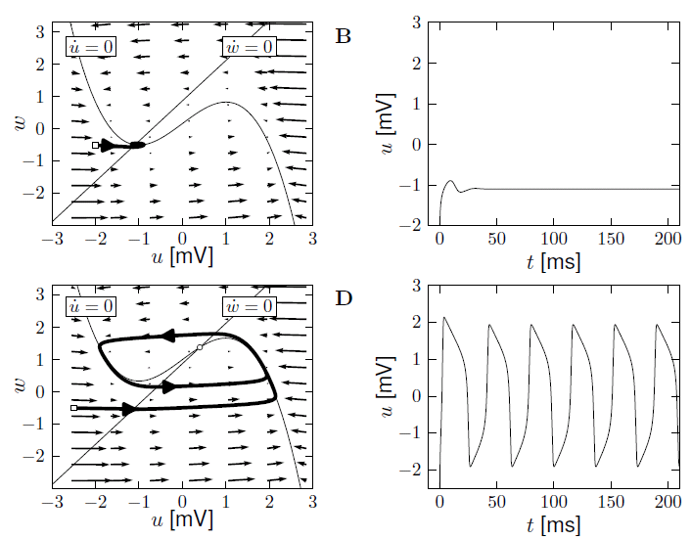
FitzHugh-Nagumo: type II Model – Hopf bifurcation
I=0
I>Ic

Slide 15
Neuronal Dynamics – 4.1, Type I and II Neuron Models
neuron
ramp input/
constant input
I0
Now:
Type I model
Type I and type II models
f-I curve
f-I curve
f
I0
I0

Slide 16
Neuronal Dynamics – 4.1. Type I and II Neuron Models
type I Model: 3 fixed points
stimulus
size of arrows!
w
apply constant stimulus I0
I(t)=I₀
u
Saddle-node bifurcation
unstable
saddle
stable

Slide 17
Saddle-node bifurcation
stimulus
w
Blackboard:
- flow arrows,
- ghost/ruins
I(t)=I₀
u
unstable
saddle
stable

Slide 18
type I Model – constant input
stimulus
w
I(t)=I₀
u
Low-frequency firing
I₀

Slide 19
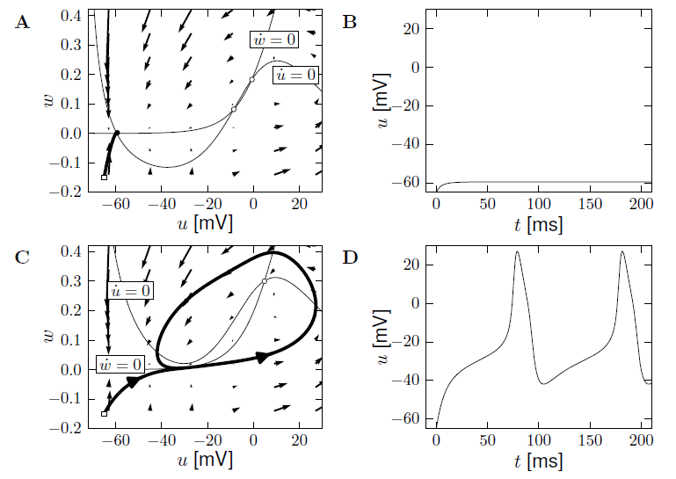
Morris-Lecar, type I Model – constant input
I=0
I>Ic

Slide 20
type I Model – Morris-Lecar: constant input
stimulus
w
I(t)=I₀
u
Low-frequency firing
I₀

Slide 21
Type I and type II models
Response at firing threshold?
Type I type II
Saddle-Node
Onto limit cycle
For example:
Subcritical Hopf
ramp input/
constant input
f-I curve
f-I curve
f
f
I0
I0
I0

Slide 22
Neuronal Dynamics – 4.1. Type I and II Neuron Models
neuron
ramp input/
constant input
I0
Type I and type II models
f-I curve
f-I curve
f
I0
I0

Slide 23
Neuronal Dynamics – Quiz 4.1.
2-dimensional neuron model with (supercritical) saddle-node-onto-limit cycle bifurcation
[ ] The neuron model is of type II, because there is a jump in the f-I curve
[ ] The neuron model is of type I, because the f-I curve is continuous
[ ] The neuron model is of type I, if the limit cycle passes through a regime where the flow is very slow.
[ ] in the regime below the saddle-node-onto-limit cycle bifurcation, the neuron is
at rest or will converge to the resting state.
B. Threshold in a 2-dimensional neuron model with subcritical Hopf bifurcation
[ ] The neuron model is of type II, because there is a jump in the f-I curve
[ ] The neuron model is of type I, because the f-I curve is continuous
[ ] in the regime below the Hopf bifurcation, the neuron is
at rest or will necessarily converge to the resting state
Notes:
Ich war hier nach 40 Minuten

Slide 24
Biological Modeling of Neural Networks
Week 4 – part 1: Reducing Detail – 2D models
3.1 From Hodgkin-Huxley to 2D
3.2 Phase Plane Analysis
3.3 Analysis of a 2D Neuron Model
4.1 Type I and II Neuron Models
- limit cycles
- where is the firing threshold?
- separation of time scales
4.2. Adding detail
Week 4
– Reducing detail
- Adding detail
Wulfram Gerstner
EPFL, Lausanne, Switzerland

Slide 25
Neuronal Dynamics – 4.1. Threshold in 2dim. Neuron Models
neuron
pulse input
I(t)
Delayed spike
u
Reduced amplitude
u

Slide 26
Neuronal Dynamics – 4.1 Bifurcations, simplifications
Bifurcations in neural modeling,
Type I/II neuron models,
Canonical simplified models
Nancy Koppell,
Bart Ermentrout,
John Rinzel,
Eugene Izhikevich
and many others

Slide 27
Review: Saddle-node onto limit cycle bifurcation
stimulus
w
I(t)=I₀
u
unstable
saddle
stable

Slide 28
Neuronal Dynamics – 4.1 Pulse input
stimulus
w
pulse input
I(t)
I(t)=I₀
u
unstable
saddle
stable

Slide 29
4.1 Type I model: Pulse input
saddle
stimulus
w
pulse input
Slow!
u
I(t)
blackboard
Threshold
for pulse input

Slide 30
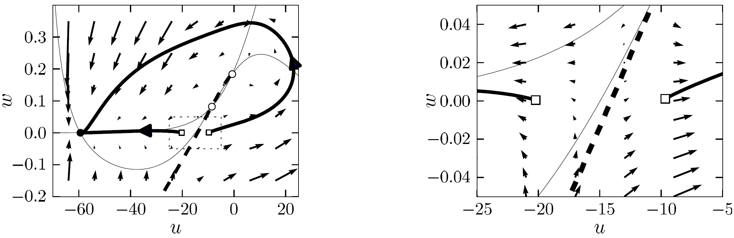
4.1 Type I model: Threshold for Pulse input
Stable manifold plays role of
‘Threshold’ (for pulse input)
Image: Neuronal Dynamics,
Gerstner et al.,
Cambridge Univ. Press (2014)

Slide 31
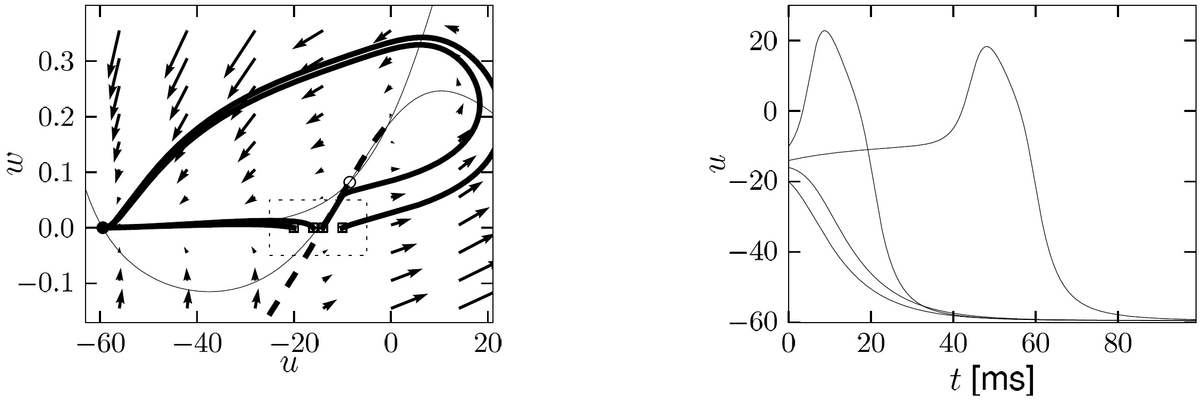
4.1 Type I model: Delayed spike initation for Pulse input
Delayed spike initiation close to
‘Threshold’ (for pulse input)
Image: Neuronal Dynamics,
Gerstner et al.,
Cambridge Univ. Press (2014)

Slide 32
Neuronal Dynamics – 4.1 Threshold in 2dim. Neuron Models
neuron
pulse input
I(t)
Delayed spike
Reduced amplitude
u
u
NOW: model with subc. Hopf

Slide 33
Review: FitzHugh-Nagumo Model: Hopf bifurcation
stimulus
w
w-nullcline
I(t)=I₀
apply constant stimulus I0
u
u-nullcline

Slide 34
FitzHugh-Nagumo Model - pulse input
stimulus
w
No explicit
threshold
for pulse input
pulse input
I(t)
u
Stable fixed point
I(t)=0

Slide 35
Biological Modeling of Neural Networks
Week 4 – part 1: Reducing Detail – 2D models
3.1 From Hodgkin-Huxley to 2D
3.2 Phase Plane Analysis
3.3 Analysis of a 2D Neuron Model
4.1 Type I and II Neuron Models
- limit cycles
- where is the firing threshold?
- separation of time scales
4.2. Dendrites
Week 4
– Reducing detail
- Adding detail
Wulfram Gerstner
EPFL, Lausanne, Switzerland

Slide 36
FitzHugh-Nagumo Model - pulse input threshold?
stimulus
w
Separation of time scales
pulse input
I(t)=0
I(t)
u
blackboard
Stable fixed point

Slide 37
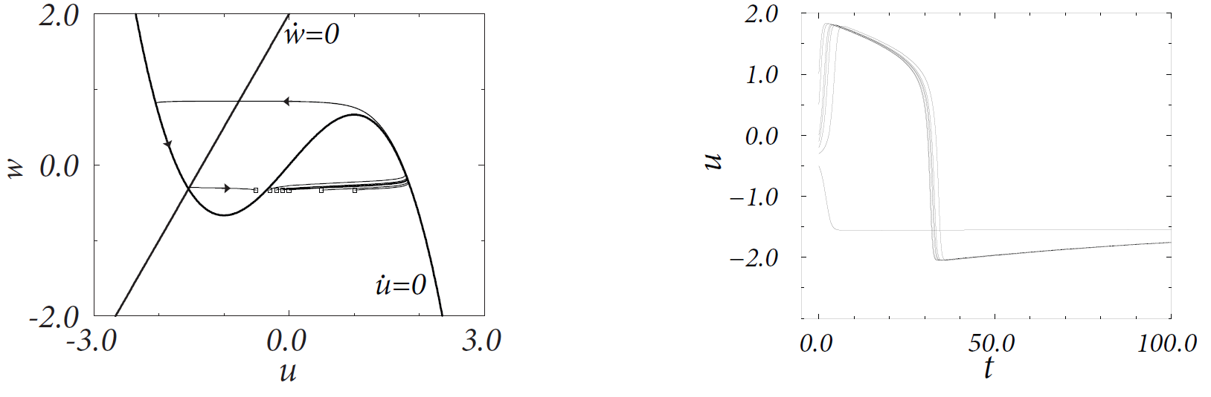
4.1 FitzHugh-Nagumo model: Threshold for Pulse input
Assumption:
Middle branch of u-nullcline
plays role of
‘Threshold’ (for pulse input)
Image: Neuronal Dynamics,
Gerstner et al.,
Cambridge Univ. Press (2014)

Slide 38
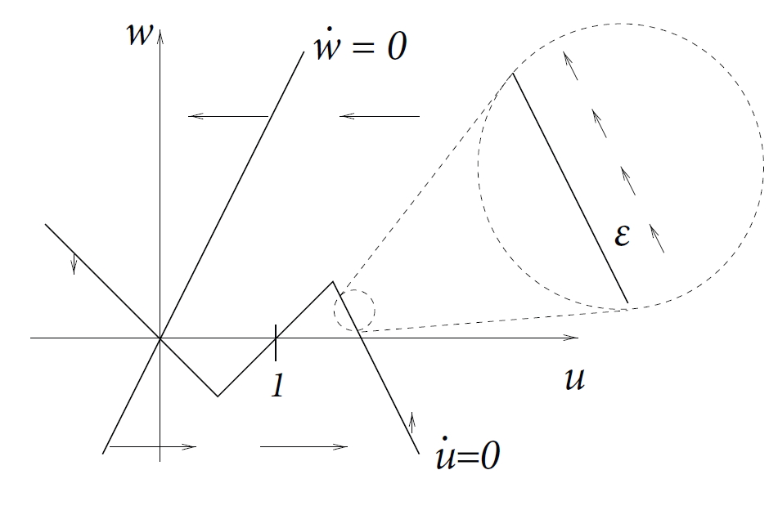
4.1 Detour: Separation fo time scales in 2dim models
stimulus
Assumption:
Image: Neuronal Dynamics,
Gerstner et al.,
Cambridge Univ. Press (2014)

Slide 39
4.1 FitzHugh-Nagumo model: Threshold for Pulse input
Assumption:
slow
fast
slow
slow
fast
slow
trajectory
-follows u-nullcline:
-jumps between branches:
slow
Image: Neuronal Dynamics,
Gerstner et al.,
Cambridge Univ. Press (2014)
fast

Slide 40
Neuronal Dynamics – 4.1 Threshold in 2dim. Neuron Models
neuron
pulse input
I(t)
Biological input scenario
Mathematical explanation:
Graphical analysis in 2D
Delayed spike
Reduced amplitude
u
u

Slide 41
Exercise 1: NOW!
inhibitory rebound
Assume separation
of time scales
w
I(t)=0
Stable fixed
point at -I0
u
I(t)=I₀<0
0
Next lecture:
10:55
-I0
I(t)
Notes:
Ich war hier um 10:40, dann 15 minuten fuer exercises.

Slide 42
Neuronal Dynamics – Literature for week 3 and 4.1
Reading: W. Gerstner, W.M. Kistler, R. Naud and L. Paninski,
Neuronal Dynamics: from single neurons to networks and
models of cognition. Chapter 4: Introduction. Cambridge Univ. Press, 2014
OR W. Gerstner and W.M. Kistler, Spiking Neuron Models, Ch.3. Cambridge 2002
OR J. Rinzel and G.B. Ermentrout, (1989). Analysis of neuronal excitability and oscillations. In Koch, C. Segev, I., editors, Methods in neuronal modeling. MIT Press, Cambridge, MA.
Selected references.
-Ermentrout, G. B. (1996). Type I membranes, phase resetting curves, and synchrony.
Neural Computation, 8(5):979-1001.
Fourcaud-Trocme, N., Hansel, D., van Vreeswijk, C., and Brunel, N. (2003). How spike generation mechanisms determine the neuronal response to fluctuating input.
J. Neuroscience, 23:11628-11640.
Badel, L., Lefort, S., Berger, T., Petersen, C., Gerstner, W., and Richardson, M. (2008). Biological Cybernetics, 99(4-5):361-370.
- E.M. Izhikevich, Dynamical Systems in Neuroscience, MIT Press (2007)

Slide 43
Neuronal Dynamics – Quiz 4.2.
Threshold in a 2-dimensional neuron model with saddle-node bifurcation
[ ] The voltage threshold for repetitive firing is always the same
as the voltage threshold for pulse input.
[ ] in the regime below the saddle-node bifurcation, the voltage threshold for repetitive firing is given by the stable manifold of the saddle.
[ ] in the regime below the saddle-node bifurcation, the voltage threshold for repetitive firing is given by the middle branch of the u-nullcline.
[ ] in the regime below the saddle-node bifurcation, the voltage threshold for action potential firing in response to a short pulse input is given by the middle branch of the u-nullcline.
[ ] in the regime below the saddle-node bifurcation, the voltage threshold for action potential firing in response to a short pulse input is given by the stable manifold of the saddle point.
B. Threshold in a 2-dimensional neuron model with subcritical Hopf bifurcation
[ ]in the regime below the bifurcation, the voltage threshold for action potential firing in response to a short pulse input is given by the stable manifold of the saddle point.
[ ] in the regime below the bifurcation, a voltage threshold for action potential firing in response to a short pulse input exists only if
Notes:
Entweder noch vor Ende der Stunde oder gar nicht (in 2014: gar nicht)

